Slide 1

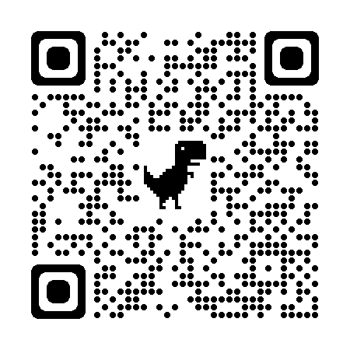




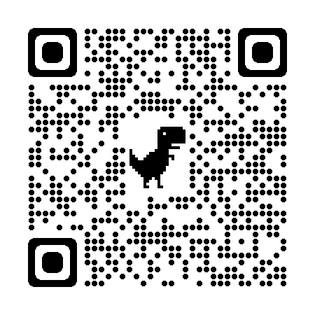





Upto 50% Off
T&C Apply
App Download
Follow
for Discounts
Coaching Classes
9073 700094
N-1/25 Patuli, Kol 94, Near Fire Brigade & Krisi Vikas
VIII-XII - All Subjects & Boards
NEET, IIT-JEE (Mains & Advanced)
Artificial Intelligence – Class III - XII
IT & AI Training & Projects
MBA, BBA, Bcom, CA, CMA, CS, CFA, CLAT, LLB, LLM
Grooming, Ielts, Toefl, Foreign Languages
Finest Teachers, Study Materials, Mock Tests, Doubt Clearing, PTM, Counselling
400+ Courses, 20 Smart Classrooms, AC, CCTV
Professional Courses are Project-Based, Certification-Oriented & Job-Focused
www.anodiam.com
anirban@anodiam.com

